Slide 1



Biocrust and EPS on Varying Substrates to Investigate Biosignatures on Mars
Embrey Saville
Anita Antoninka, Keven Griffen, Natalie Jones, Kayla Blair
AZSGC Student Research Symposium
April 20th 2024

Slide 2
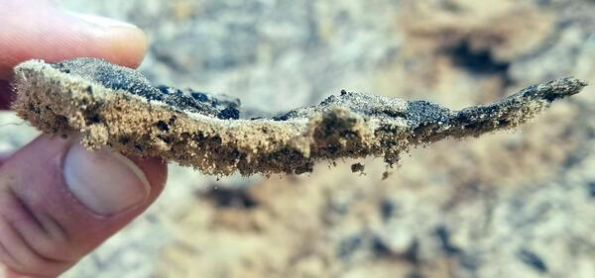
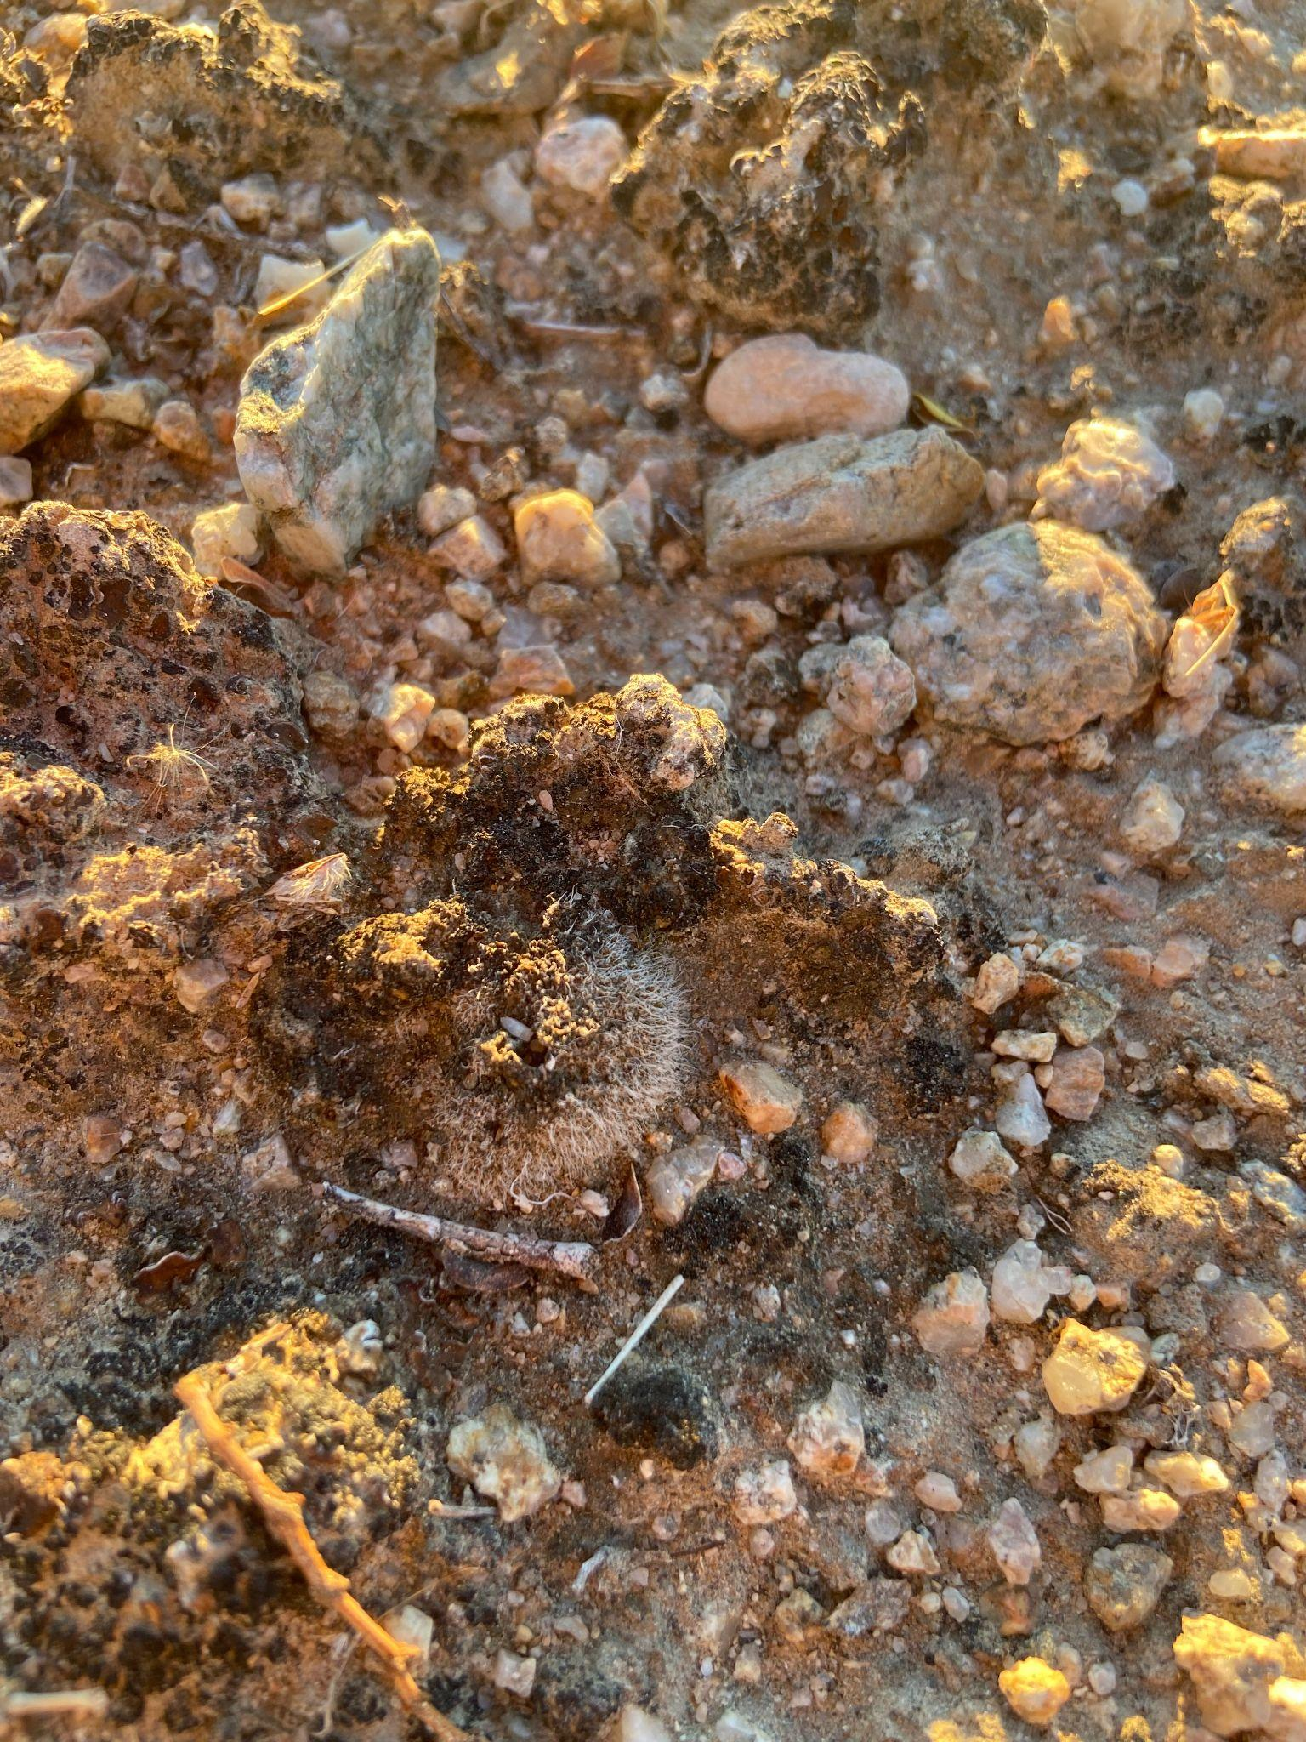
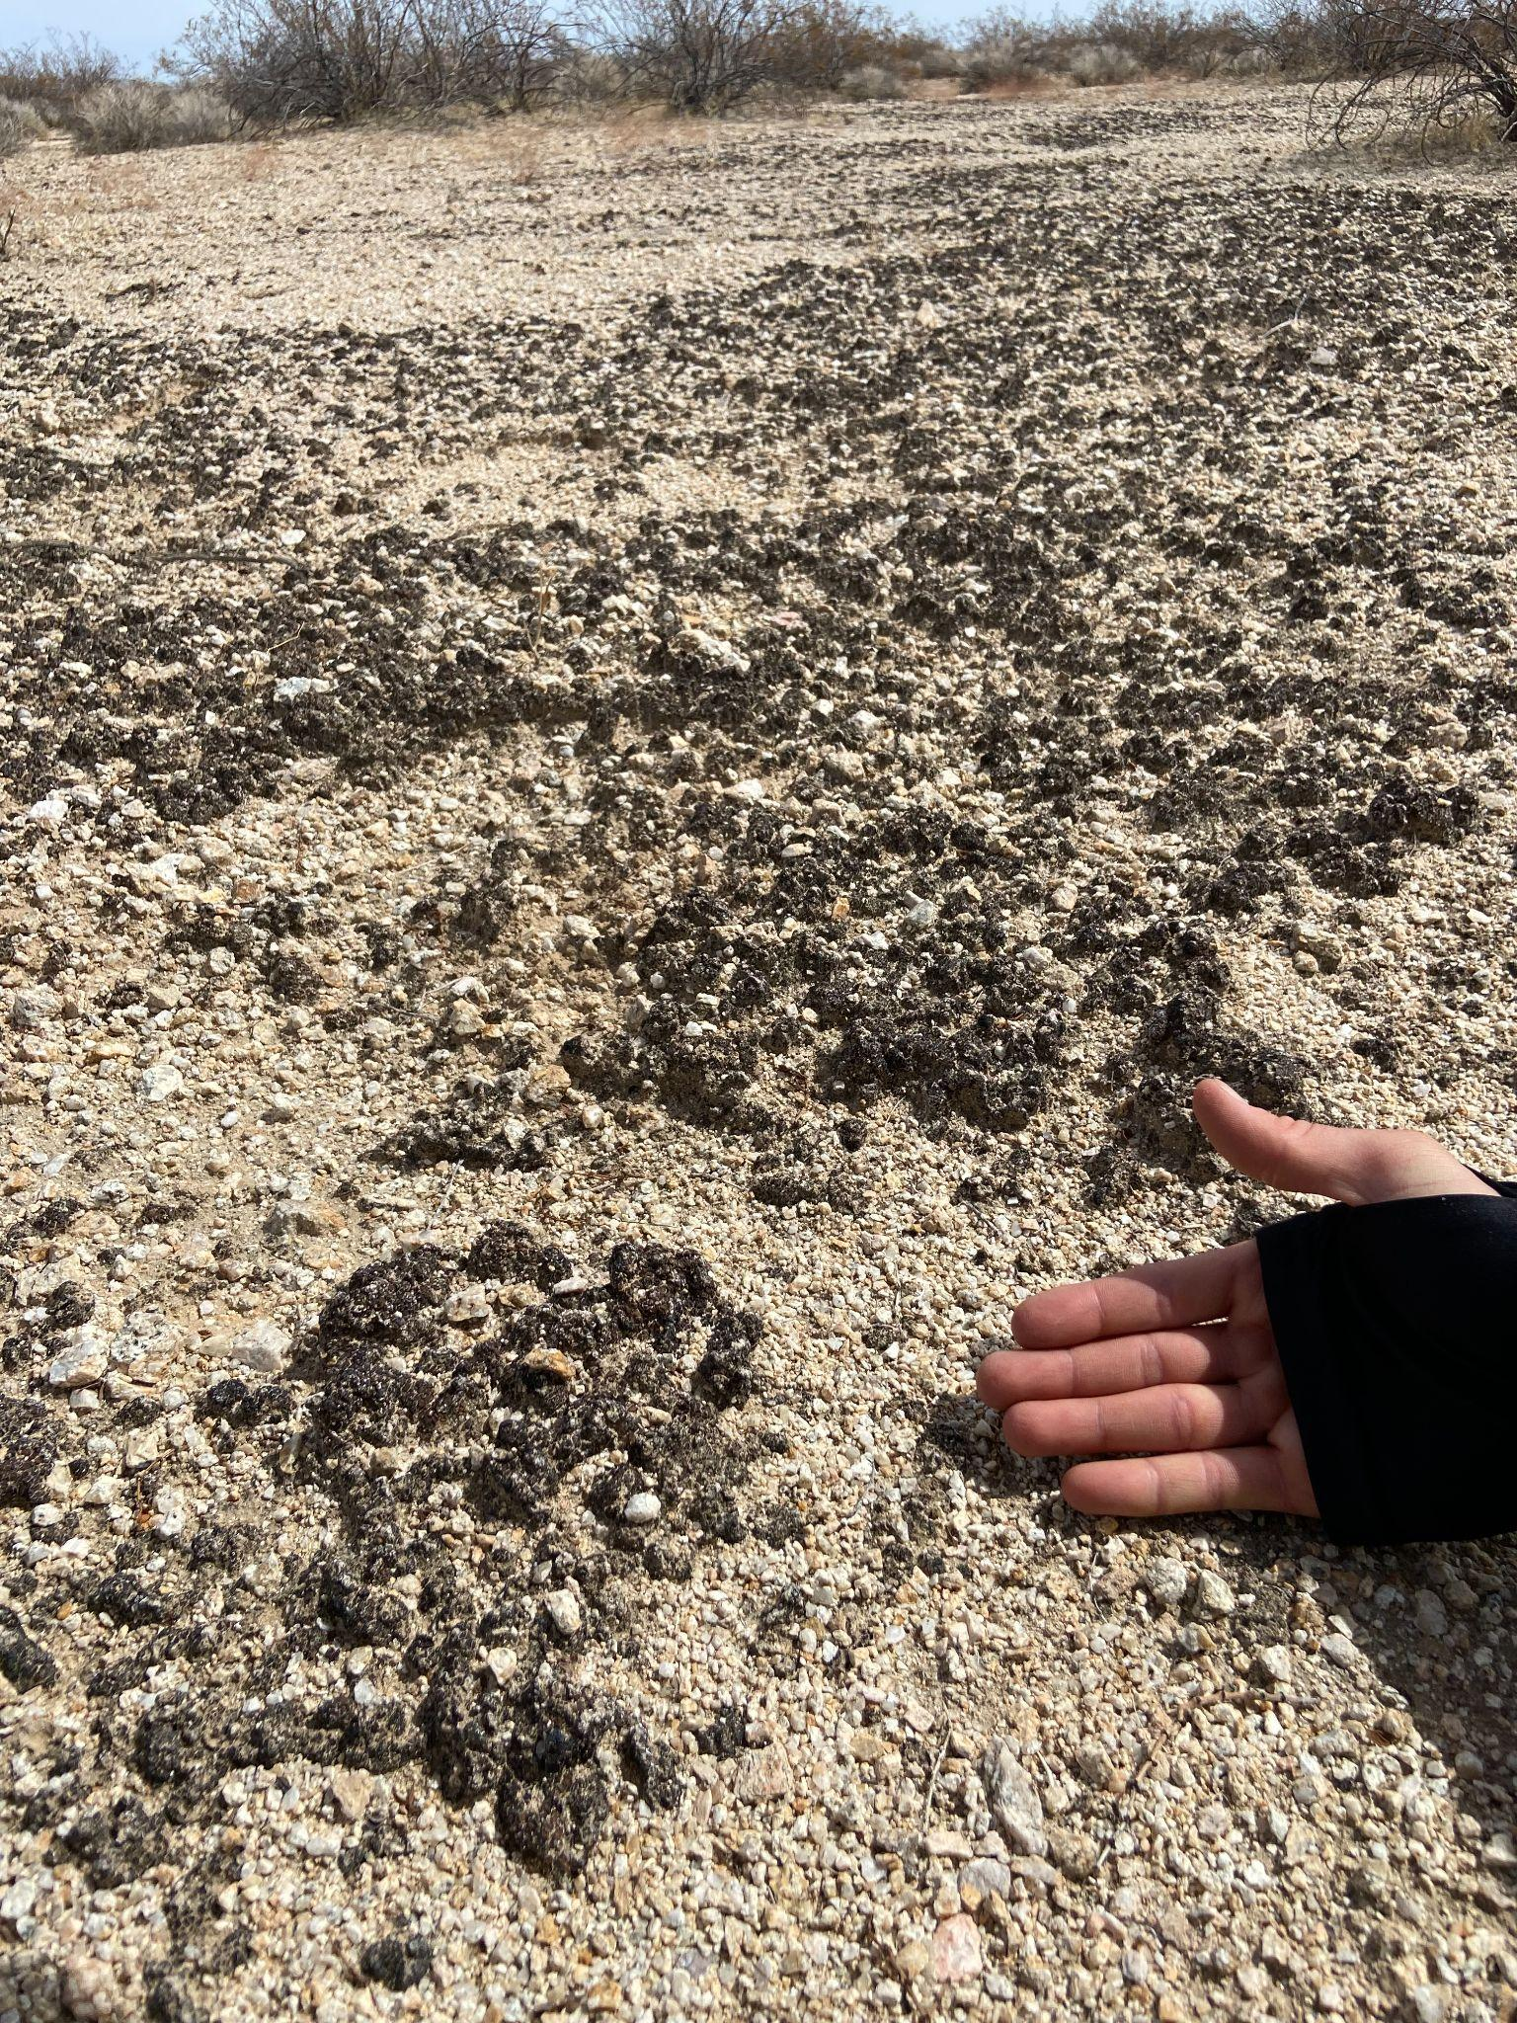
What is Biocrust?
(5)
Lichens, cyanobacteria, and moss grown in dryland areas
Crucial in increasing soil stability of Earth’s drylands
Cyanobacteria was one of the first to inhabit on Earth
Important for Mars biosignature studies
(2)
(2)
Notes:
FINISH

Slide 3
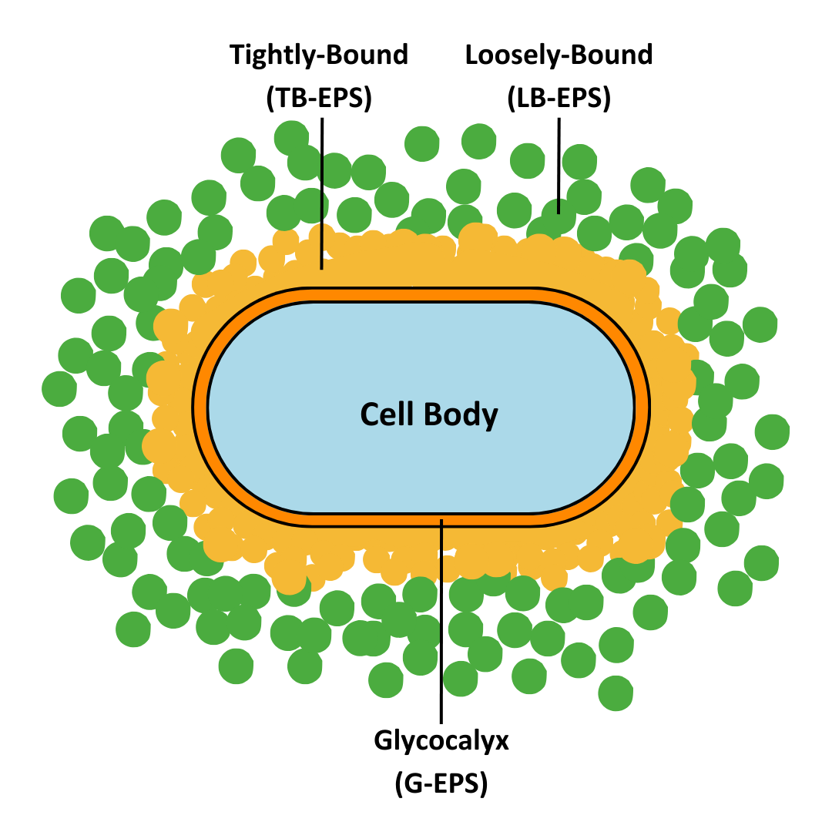
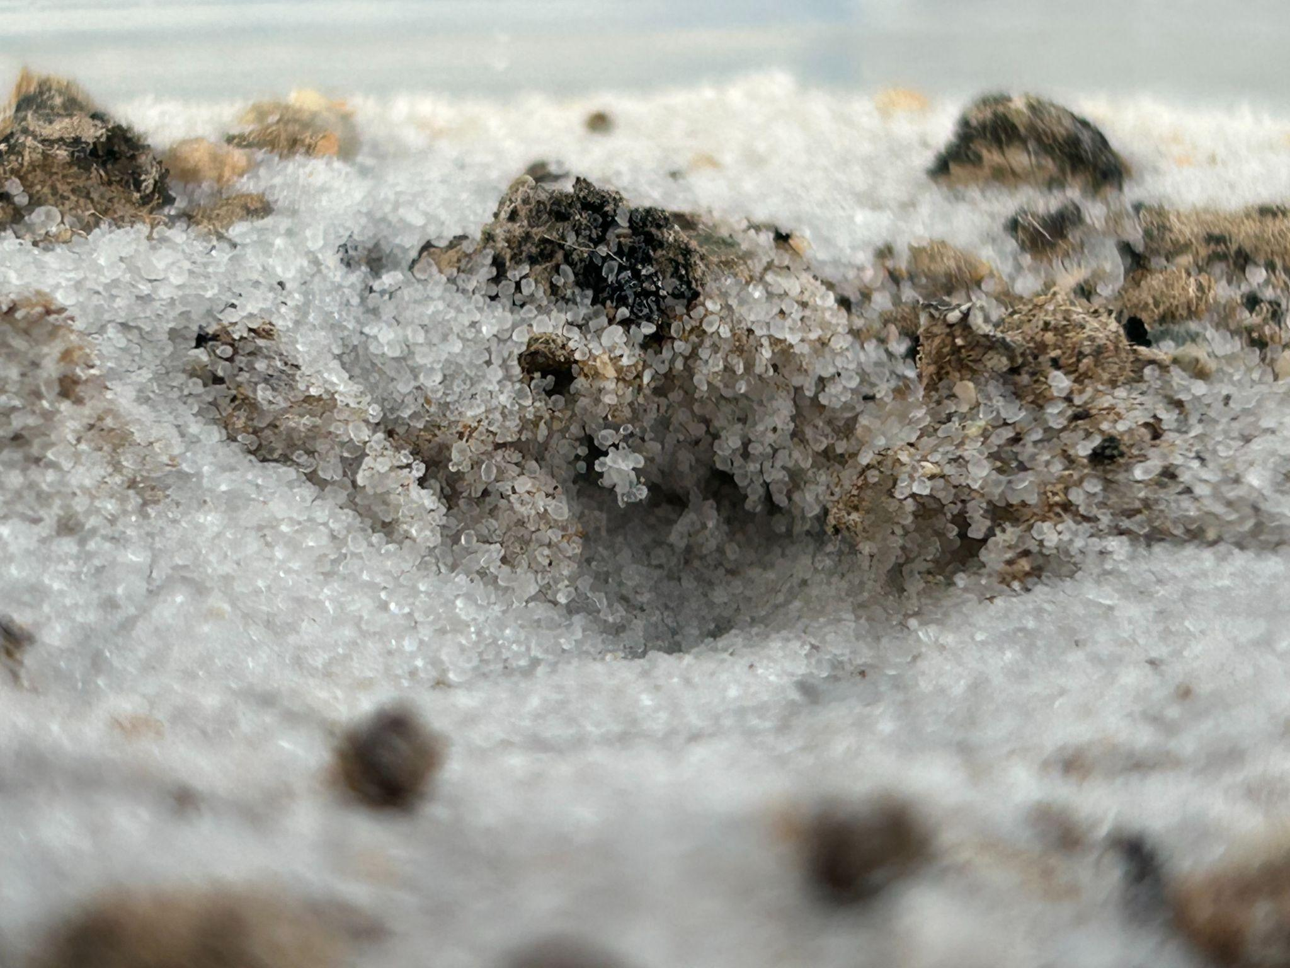
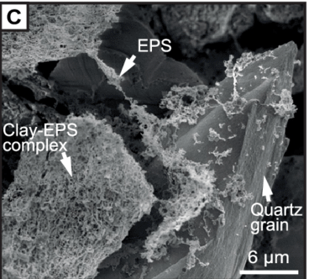
What is EPS?
Extracellular Polymeric Substances
a sticky protective biopolymer that is excreted by biocrust and adheres to iron oxides and clays
Like slugs, microbes excrete a type of mucus
Naked eye visualization of EPS
(5)

Slide 4
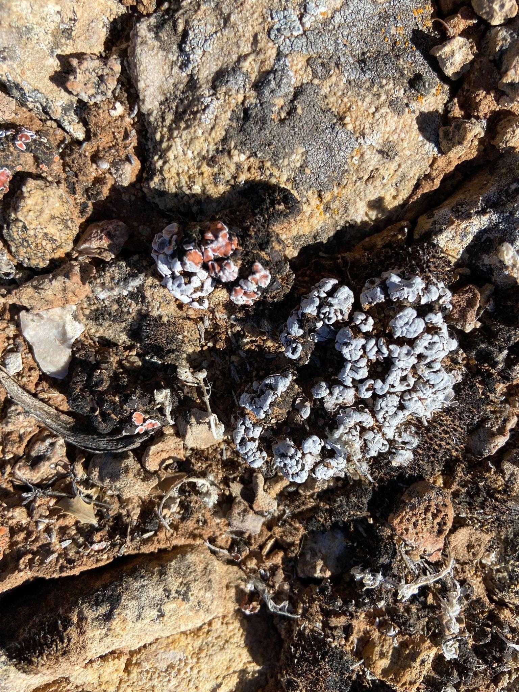
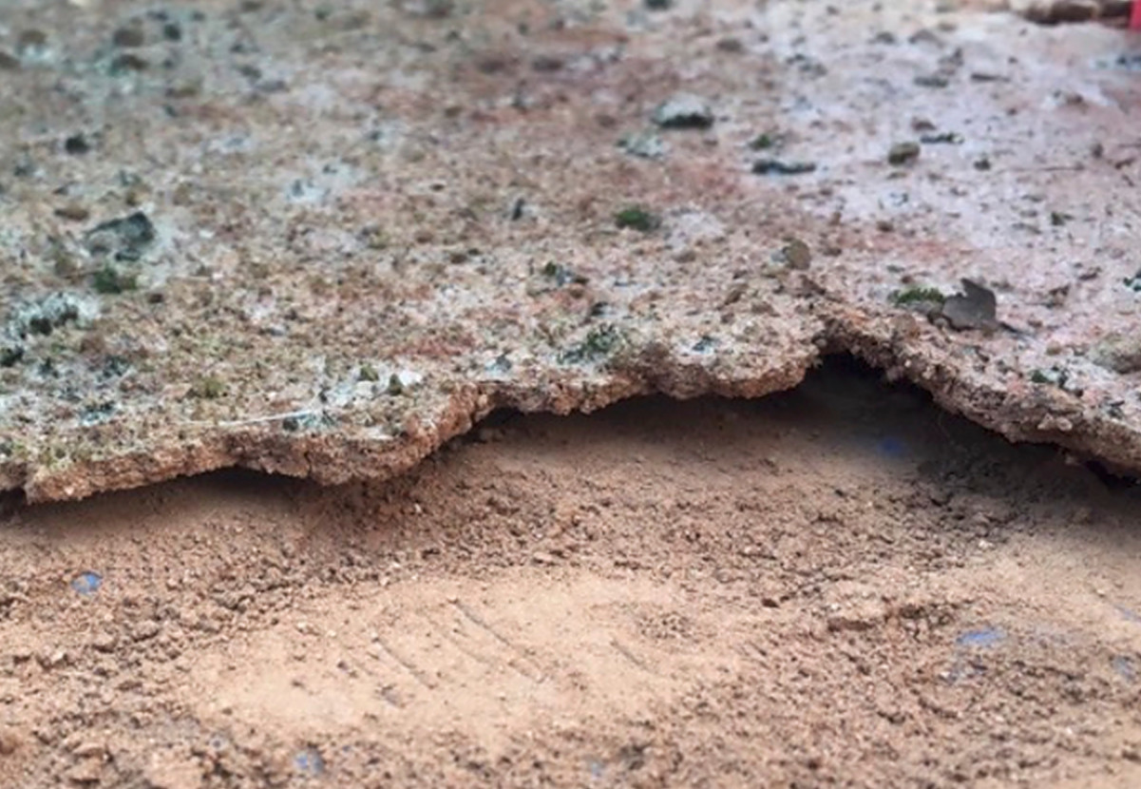
Questions/Hypotheses
Question:
How does crust cover change over time across different substrate types, and do specific crust components show varying trends depending on substrate?
Can we grow where none have grown before?
Hypothesis:
Expected effect on crust cover due to substrate type
Expected increase in light cyanobacteria in 100% sand treatment
Expected decrease in chemical regolith crusting with no growth present
(2),(1)

Slide 5
Questions/Hypotheses
Questions:
How does crust cover change over time across different substrate types, and do specific crust components show varying trends depending on substrate?
Can we grow where none have grown before?
Hypotheses:
Expected effect on crust cover due to substrate type with increase in light cyanobacteria
Mars regolith will allow cyanobacteria to form with minor growth in lichens
(2),(1)

Slide 6
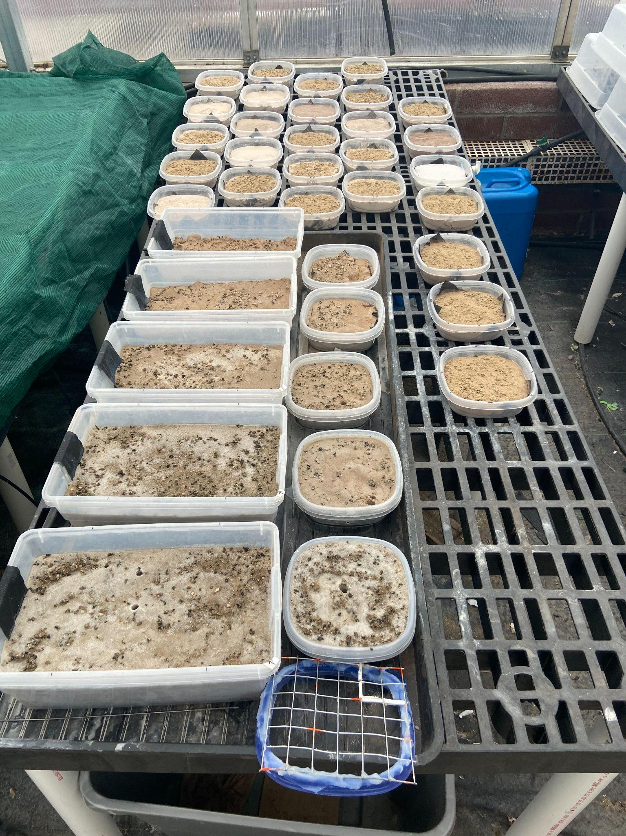
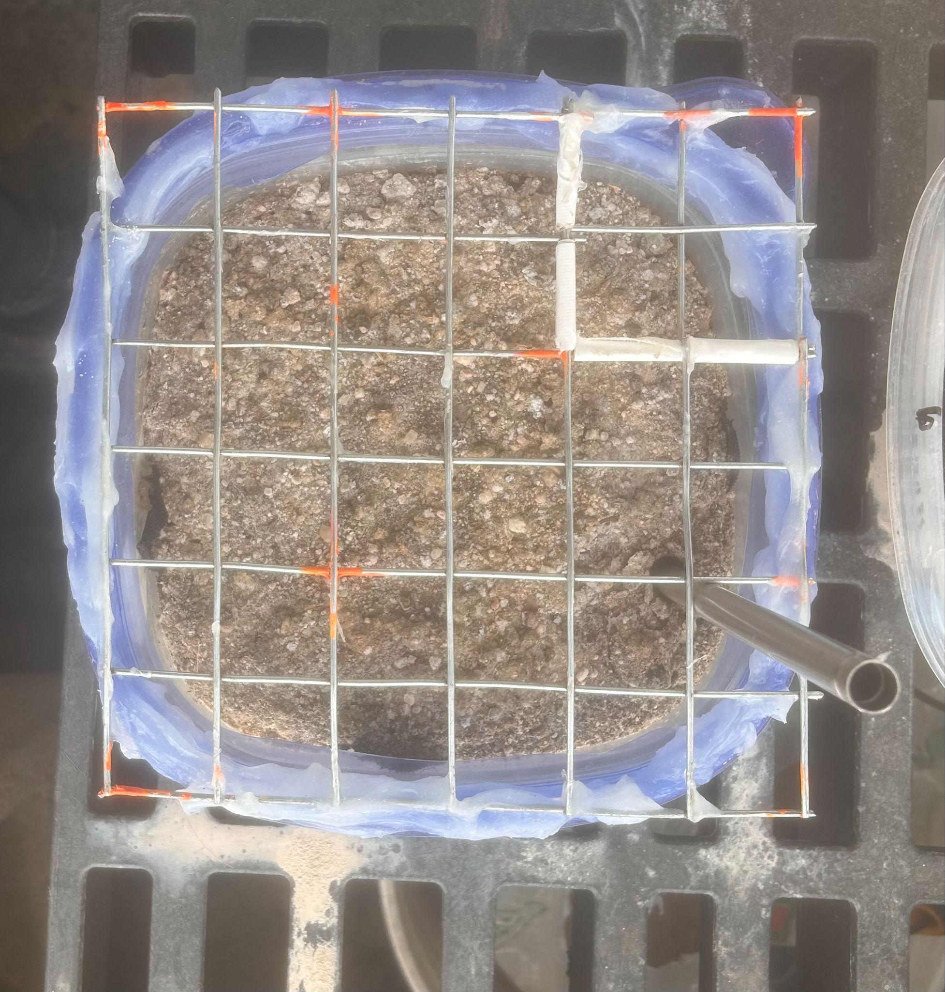
Methods
Inoculated 10 pilot tubs and 27 small tubs with various substrate concentrations
Clay
Sand
Mars Simulant
Weekly point-intercept framing data
Biweekly EPS sampling
EPS chemical
extraction
through phenol
and sulfuric acid
and a fluorescence
microplate reader

Slide 7
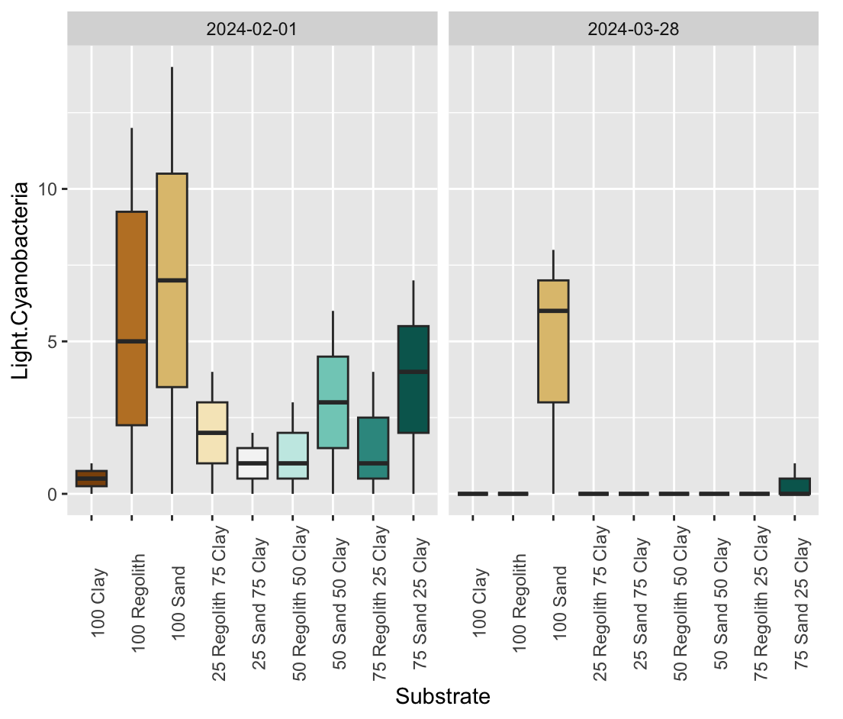
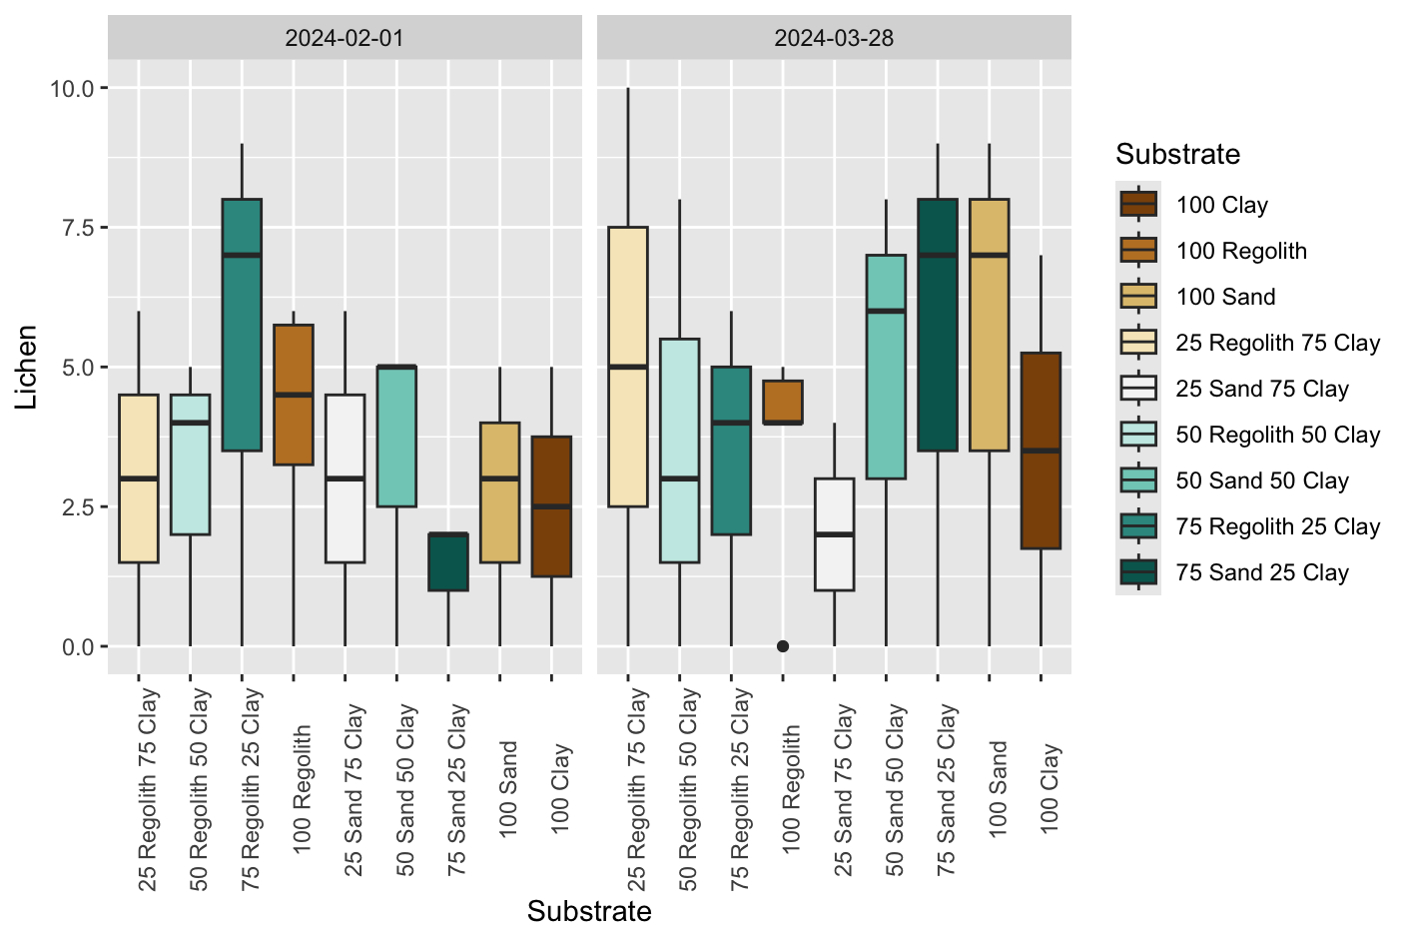
Light Cyanobacteria VS. Lichens

Slide 8
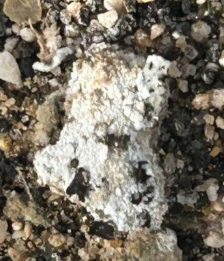
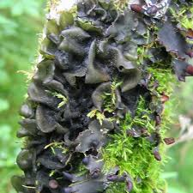
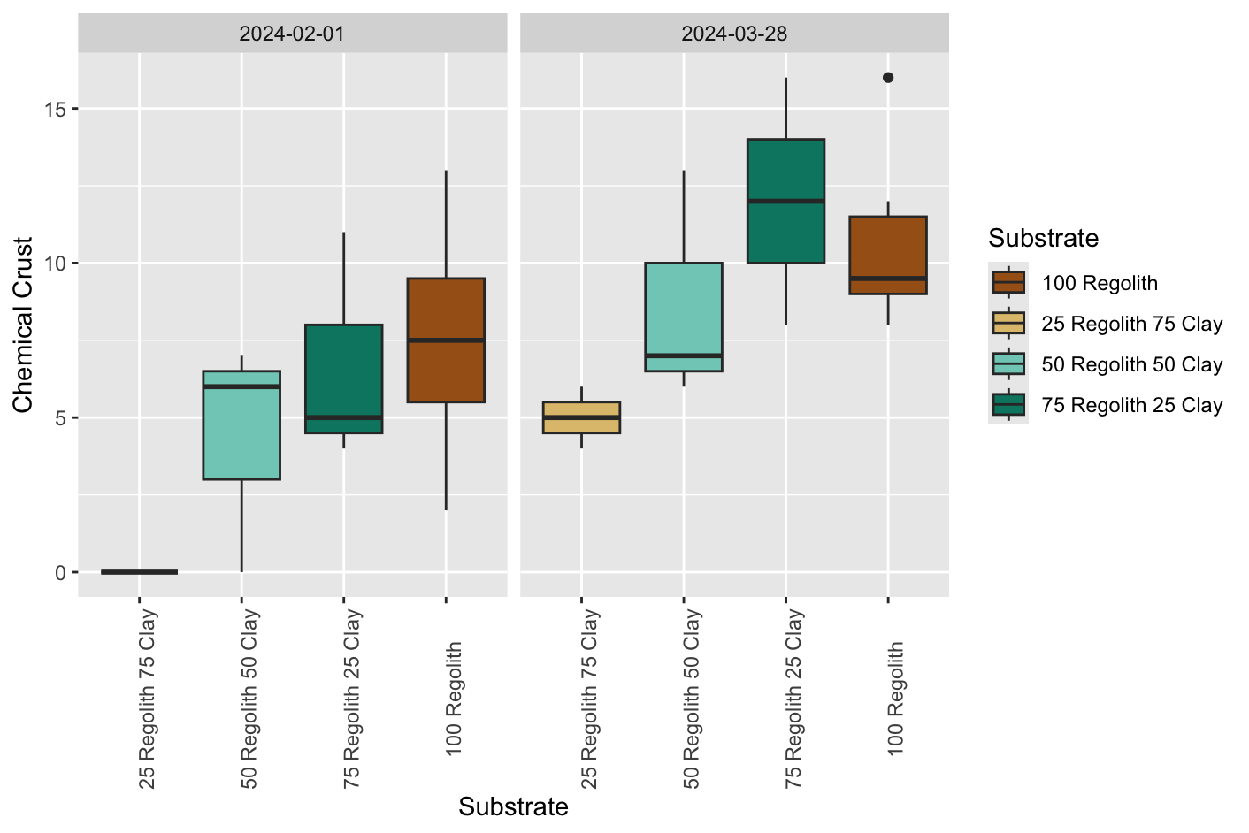
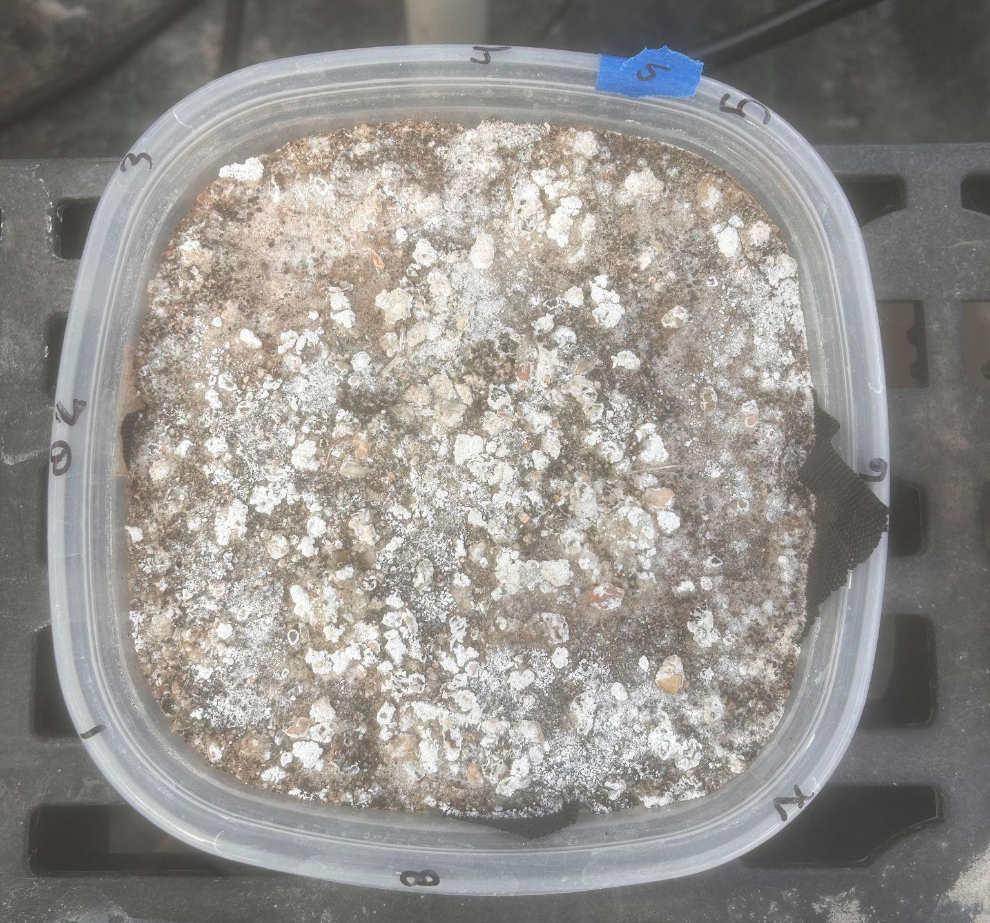
Regolith Chemical Crusting
Magnesium Sulfate (MgSO₄)
Possible termination of Lichens
Notes:
ADD PICTURE OF HEALTHY LICHEN

Slide 9
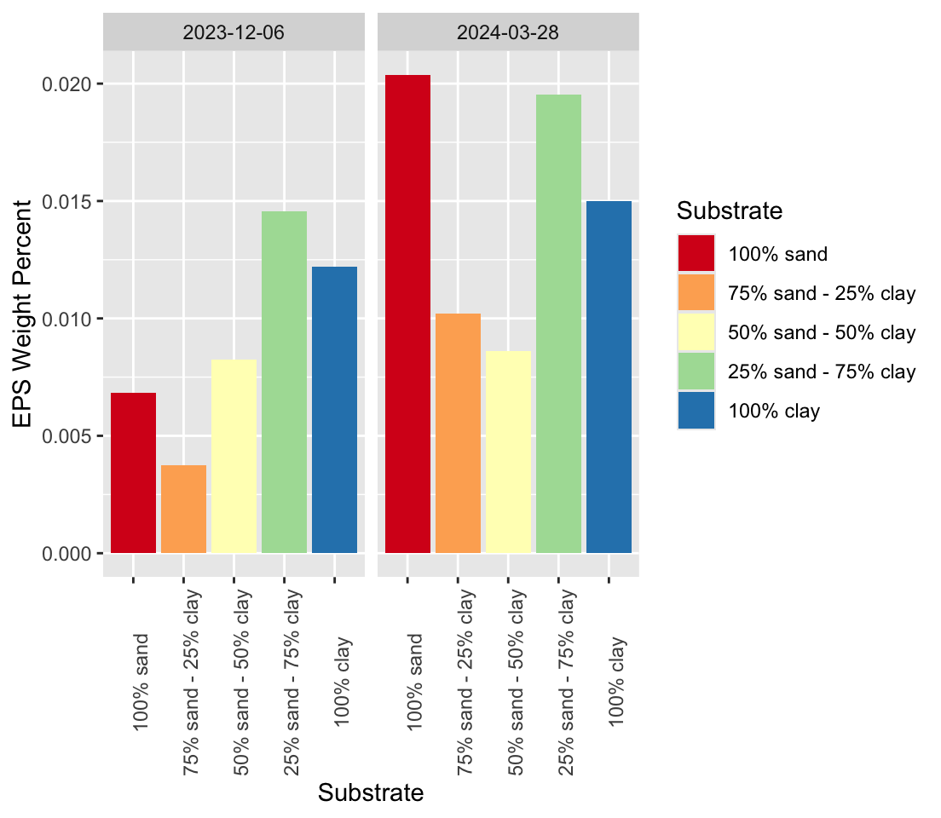
EPS
Notes:
DO GRAPH

Slide 10
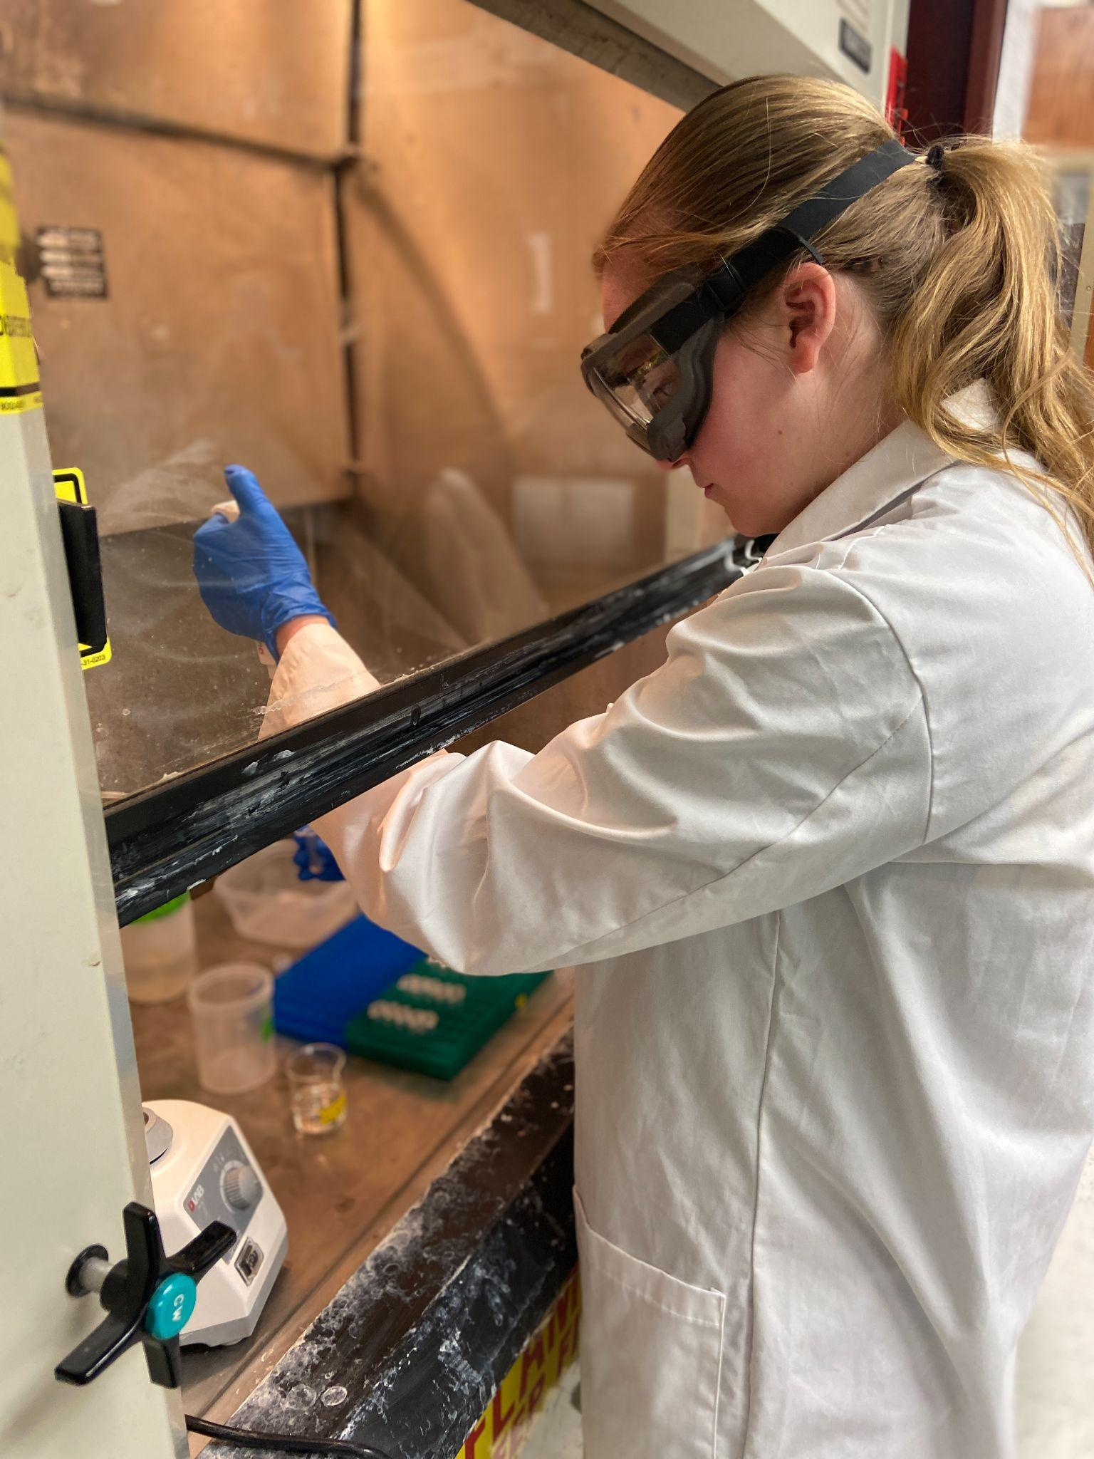
Future Directions
Complete a chemical analysis on regolith chemical crusting to determine components
Continue greenhouse framing and EPS for longer data points
Continue EPS analysis to analyze possible biosignatures on Mars
Look into other Mars Environmental factors that could affect EPS and biocrust growth
Notes:
discuss their interpretations and provide insight for the future direction of their work (FINISH)

Slide 11
References
(1)says, D. Solar can promote biocrust formation in deserts. pv magazine International. https://www.pv-magazine.com/2023/04/26/solar-can-promote-biocrust-formation-in-deserts/ (accessed 2024-04-04).
(2)Griffen, K. Biological Soil Crust Pictures ; 2024.
(3)Blair, K. EPS Pictrogram; 2024.
(4)Planetary Simulant Database: MGS-1 Mars Global Simulant. Center for Lunar & Asteroid Surface Science. https://sciences.ucf.edu/class/simulant_marsglobal/.
(5) Biological Soil Crust (“Biocrust”) Science | U.S. Geological Survey. www.usgs.gov. https://www.usgs.gov/centers/southwest-biological-science-center/science/biological-soil-crust-biocrust-science (accessed 2024-04-04).

Slide 12
Thank You

